Slide 1
TLS/SSL & TLS RECORD PROTOCOL
Presented by
Mahir Mahbub BSSE 807
Md. Hasan Tarek BSSE 818
Afia Sajeeda BSSE 832
Sefat E Mahadi BSSE 839

Slide 2
Secure Socket Layer (SSL)
SSL certificates are employed to encrypt the communications taking place between client and server. SSL, the protocol behind SSL certificates, was first published by Netscape in 1995.

Slide 3
Transport Layer Security (TLS)
Transport Layer Security, or TLS, is a widely adopted security protocol designed to facilitate privacy and data security for communications over the Internet.
TLS evolved from a previous encryption protocol called Secure Socket Layer (SSL)
TLS version 1.0 actually began development as SSL version 3.1

Slide 4
Transport Layer Security (TLS)
Technically, TLS consists of two parts:
The TLS handshake layer manages which cipher (the type of encryption algorithm) will be used, the authentication, and the key exchange (based on the public-private key pair from the certificate). The handshake process is performed only once to establish a secure network connection for both parties.
The TLS record layer gets data from the user applications, encrypts it, fragments it to an appropriate size (as determined by the cipher), and sends it to the network transport layer.

Slide 5
Transport Layer Security (Cont.)
TLS can be used on top of a transport-layer security protocol like TCP
There are three main components to TLS: Encryption, Authentication, and Integrity.
Encryption: hides the data being transferred from third parties.
Authentication: ensures that the parties exchanging information are who they claim to be.
Integrity: verifies that the data has not been forged or tampered with.

Slide 6
Transport Layer Security (Handshaking)
TLS Handshake Protocol
A TLS connection is initiated using a sequence known as the TLS handshake
The TLS handshake establishes a cypher suite for each communication session (shared encryption keys, or session keys)
Set the matching session keys over an unencrypted channel using public key cryptography
Handshaking handles authentication which usually consists of the server proving its identity to the client. Authentication done using public keys.
Once data is encrypted and authenticated, it is then signed with a message authentication code (MAC).
The recipient then verify the MAC to ensure the integrity of the data

Slide 7
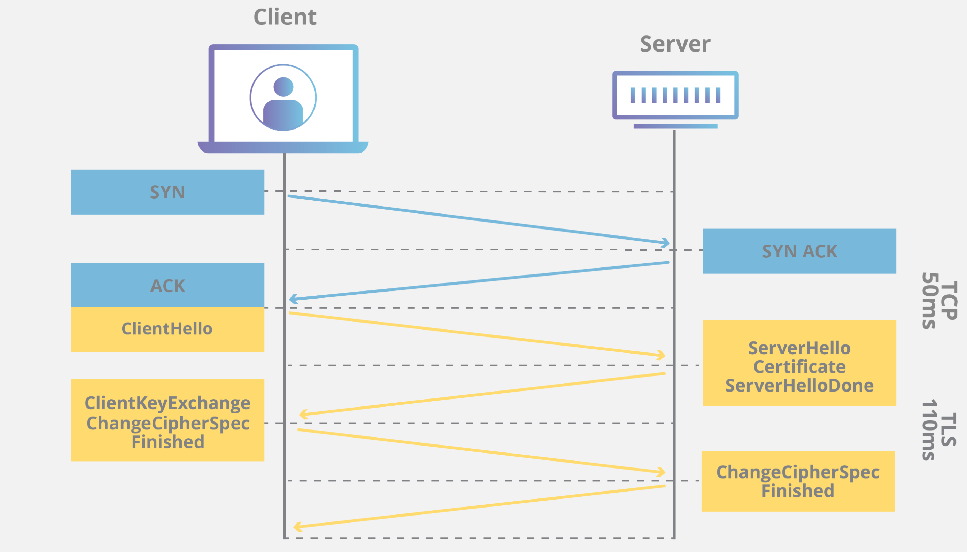
Handshaking Protocol

Slide 8
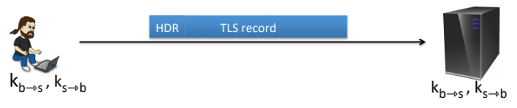
TLS Record Protocol
The data encryption TLS is done using a protocol called TLS Record Protocol.
The record( encrypted data) is at most 16 KB. If record’s size >16KB, then the data is to be fragmented into multiple records.

Slide 9
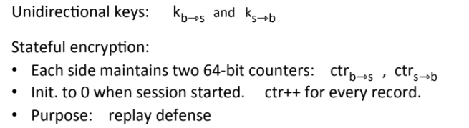
TLS Record Protocol

Slide 10
TLS Record Protocol
Purpose of Counter:
Prevention of replay attack so that the attacker cannot record the record and replay at a later time because by then the counters will be incremented.

Slide 11
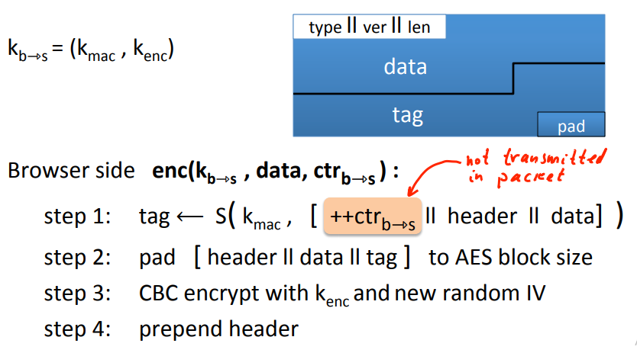
TLS Record Protocol-Encryption

Slide 12

TLS Record Protocol-Encryption
Uses CBC AES-128 and HMAC-SHA1
*HMAC-SHA1 is typically MAC Algorithm with nested secret prefix and symmetric key hash function.
M=h(k || h (k || x))
Inner hash outer hash

Slide 13
TLS Record Protocol-Encryption
Interesting thing is that the counter value is never included in the record in step 1.
N.B: MAC happens first and then encryption takes place.
For example: If the padding needs to be 5, then the padding would be just 55555 in step 2.

Slide 14
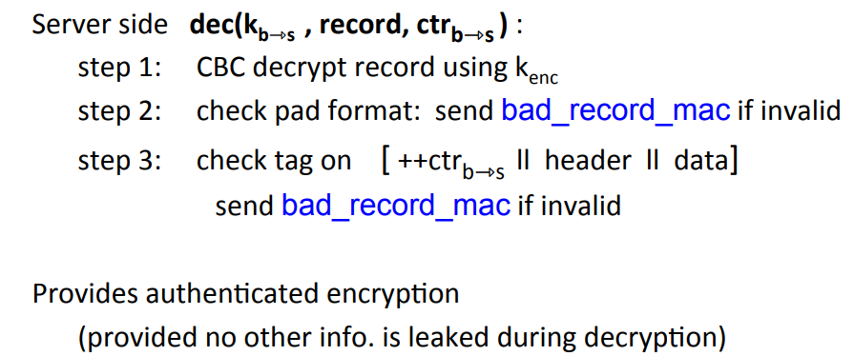
TLS Record Protocol-Decryption
Uses CBC AES-128 and HMAC-SHA1

Slide 15
TLS Record Protocol-Decryption
For example, if the pad length is five bytes, it is going to verify if the last five bytes is 55555. If last five bytes is not 55555, bad_record_mac message will be sent and the connection will be terminated.
This leads to a new session key to be negotiated if more records need to be sent.

Slide 16
TLS Applications
Most recent version is TLS 1.3, which was published in 2018
A primary use case of TLS is encrypting the communication between web applications and servers,
Encrypting communications such as email, messaging, and voice over IP (VOIP)

Slide 17
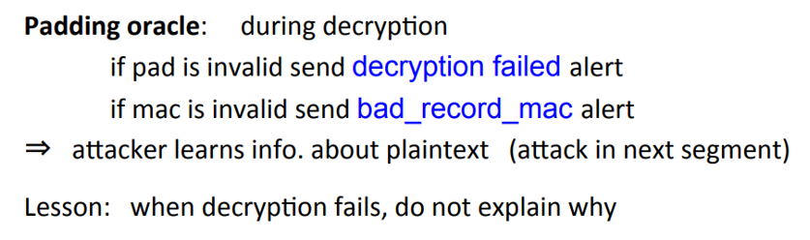
Bugs in Older Versions
Solved after TLS 1.0
Instead of using decryption_failed message uses bad_record_mac
Prevents Padding Attack
Should not explain why the failures occures

Slide 18
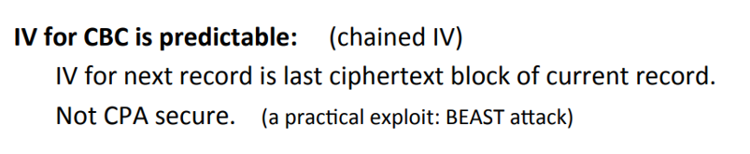
Bugs in Older Versions
Solved after TLS 1.1
Using explicit IV where each TLS record has own random IV

Slide 19
Bugs in Older Versions
The SSL 3.0 Vulnerability – POODLE Bug (AKA POODLEbleed
Exploitation happend by intercepting data that’s supposed to be encrypted between computers and servers using man-in-the-middle (MITM) attack

Slide 20
Bugs in Older Versions (POODLE Bug)
To work with legacy servers, many TLS clients implement a downgrade
First handshake attempt, offer the highest protocol version supported by the client; if this handshake fails, retry (possibly repeatedly) with earlier protocol versions.
This downgrade can also be triggered by network glitches, or by active attackers.
So if an attacker that controls the network between the client and the server interferes with any attempted handshake offering TLS 1.0 or later, such clients will readily confine themselves to SSL 3.0.

Slide 21
Bugs in Older Versions
The attacker controls both the request path and the request body, and can induce requests such that the following two conditions hold
The padding fills an entire block (encrypted into Cn)
The cookies’ first as-of-yet unknown byte appears as the final byte in an earlier block (encrypted into Ci).
The attacker then replaces Cn by Ci and forwards this modified SSL record to the server.
Usually, the server will reject this record, and the attacker will simply try again with a new
request. Occasionally (on average, once in 256 requests), the server will accept the modified record

Slide 22
Issues in Older Versions
TLS 1.3 eliminated a number of older algorithms that did nothing other than create vulnerabilities. These include
RC4 Steam cipher
DES
3DES
RSA Key transport
SHA-1 hashing
CBC Mode ciphers
MD5
Diffie-Hellman groups
EXPORT ciphers

Slide 23
Leaking the Length
The TLS header leaks the length of TLS records
Lengths can also be inferred by observing network traffic
Many web applications, leaking lengths reveals sensitive info
In tax preparation sites, lengths indicate the type of return being filed which leaks information about the user’s income
In healthcare sites, lengths leaks what page the user is viewing
In Google maps, lengths leaks the location being requested No easy solution

Slide 24
Pros: SSL/TLS Security
Prevent intruders from tampering with the communication between your website and web browsers. Intruders can be malicious attackers or benign invaders. Sensitive data, such as the user’s login credentials, credit card details, and email info, must never be revealed over the network.
Prevent intruders from passively listening to communications with your server. This is a somewhat elusive, but growing, security threat

Slide 25
Cons: SSL/TLS
TLS will add latency to on site’s traffic.
The handshake is resource-intensive. It uses asymmetric encryption to establish a session key, which then allows the client and server to switch to a faster symmetric encryption
TLS will add complexity on server management. Need to get a certificate installed on web server and maintain the validity of that certificate.

Slide 26
Thank You

